Slide 1

Facebook:
Private
Personal Information
By Aliza, Leya, Salma and Yashna

Slide 2





Access To Camera and Microphone
Facebook asks for it to have access to your camera and microphone. Access has to be granted in order to post a personal picture or video. After you grant Facebook access to your camera and microphone, your camera roll is in their system as well as your voice recordings. They can also use the microphone to hear your normal conversations to help determine what advertisements they should send to you.

Slide 3

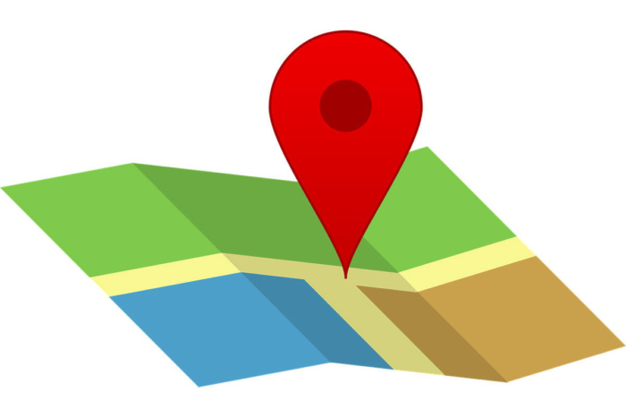
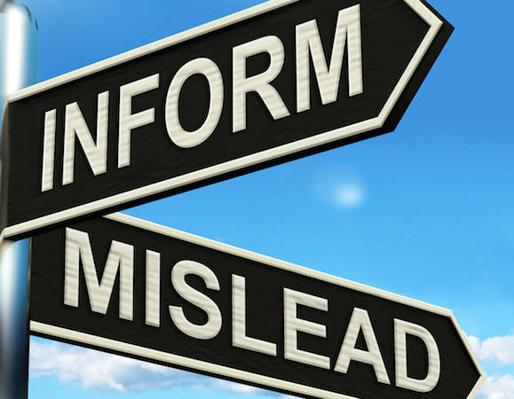

Access to Location
Facebook asks for permission to see your location so they can track where you are. They can also take the locations you have been to and send advertisements and misinformation about the locations.

Slide 4


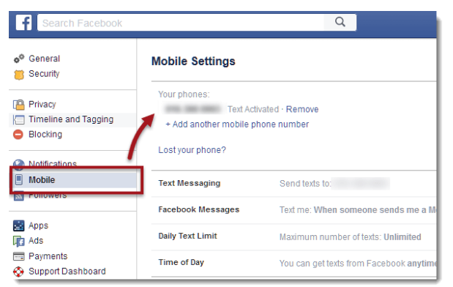
Access to Messages/Phone
Facebook requests access to messages and phone number so that they can message and call you for updates. Facebook processes this information and puts it in their system. They then have access to your conversations with others as well as your number, which aren’t private anymore.

Slide 5

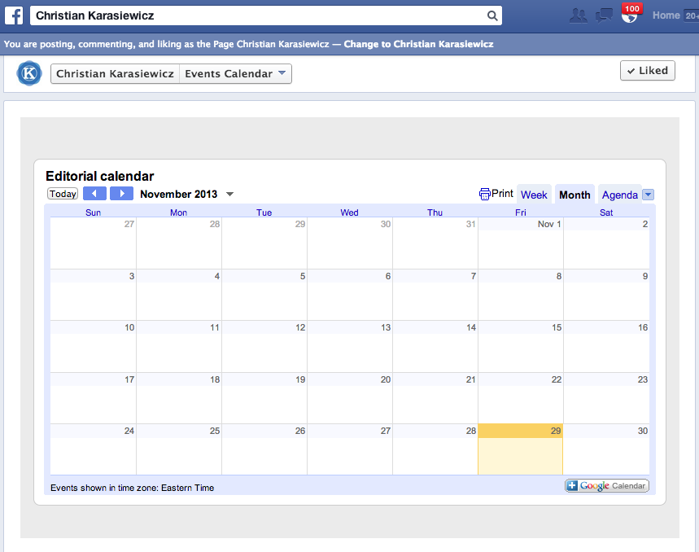
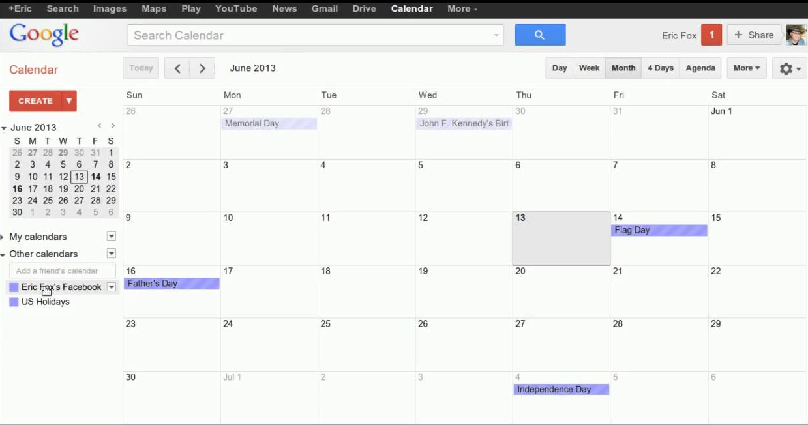
Access to Calendar
Facebook request access to your calendar so they can transfer any facebook events onto your personal calendar. They also request access to place all the events on your personal calendar onto your facebook calendar.
Transferring Data

Slide 6

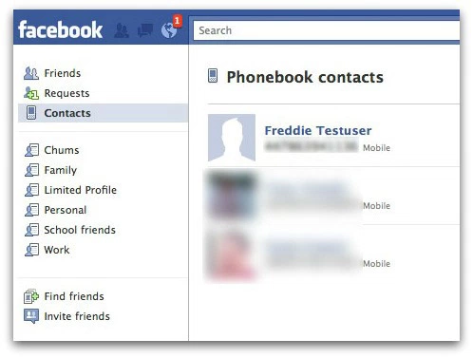
Access to Contacts
Facebook will ask you to connect your account with your list of contacts on your phone to see if any of your contacts have Facebook and you can become friends with them quicker. They will process this information and know who you know and who you’re friends with.

Slide 7
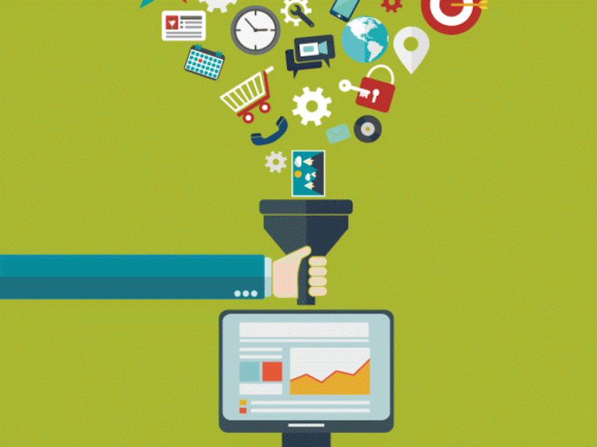
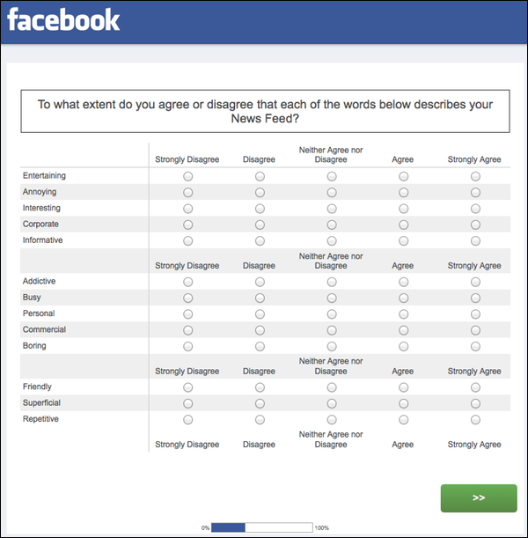
How the Data is Collected
Facebook collects information by requesting access to other applications on the user’s device. They also collect data by looking profiles of the user and their friends and families. Also a big part of collecting data is through the things you share an interest to. Also Facebook collects information through access that mainly the persons allows to such as questionnaires when you begin making your account.

Slide 8
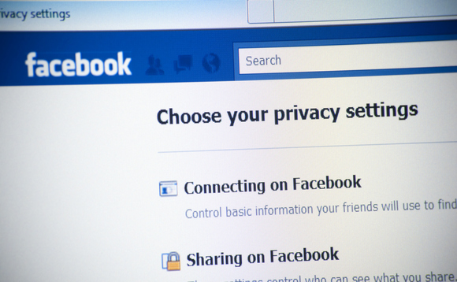

What is the Data Used For
The data that Facebook collects is used for targeted marketing purposes.
Facebook would send you advertisements based off of the searches users made or their location.
Facebook might take into account where you live to send you targeted regional ads.

Slide 9


